Slide 1
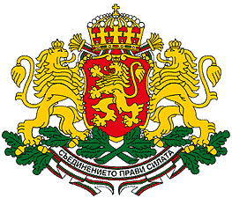
Bulgaria

Slide 2
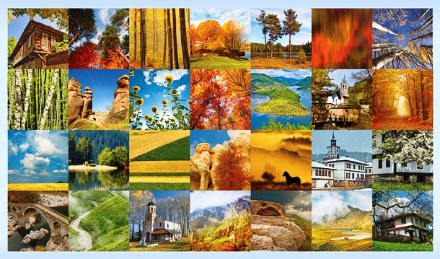
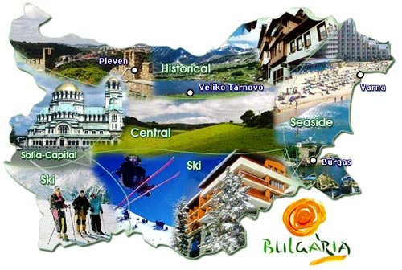
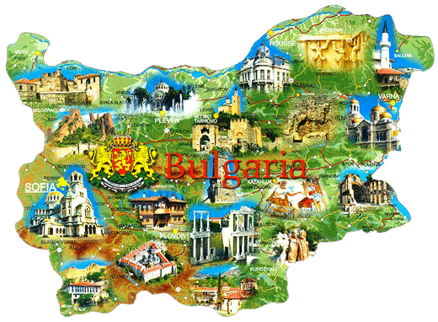
Bulgaria: a part of Eden
A legend says:
when God was giving away land to peoples, the Bulgarian was working on a field and he came last to take his part. He was known as a good and hard-working man and God decided to give him a part of his land – the Eden.

Slide 3
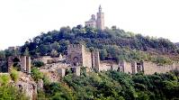

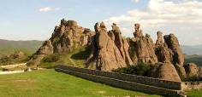

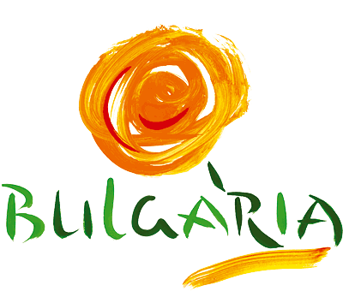
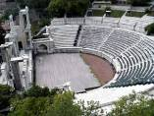




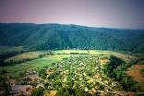
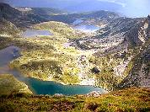
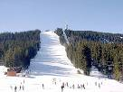
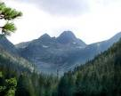
Bulgaria is a country of old history, ethnological and cultural heritage and beautiful nature
Sea Resorts
Nature Landmarks
Historical Heritage
Cultural Sightseeing
Ancient Buildings
Ski Resorts
Nature Parks
Beautiful Nature

Slide 4
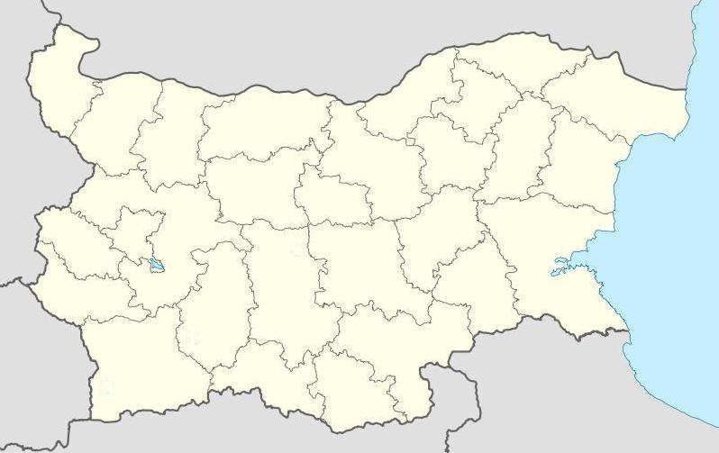















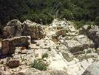


Bulgaria at a glance
Fortress Tsarevets
Veliki Preslav
Fortress Kaliakra
Baba Vida Fortress
Fortress Pliska
Magura cave
Belogradchik Rocks
Sofia
Troyan monastery
Etar
Nessebar
Vitosha mountain
Kazanluk's Thracian Tomb
Ancient Plovdiv
Rila monastery
Sozopol
Rupite
Pyramids of Melnik
Perperikon

Slide 5
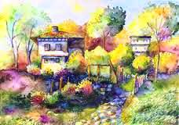
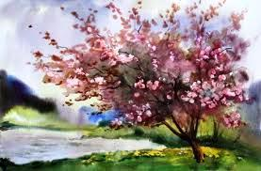
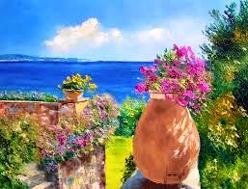
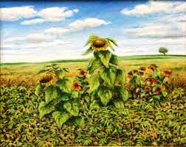
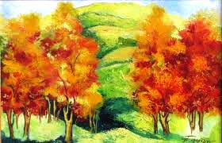
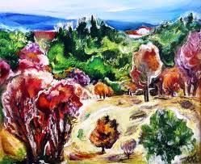
Bulgaria is like a miniature of all natural beauties: magnificent mountain ridges, cozy sand and stone beaches, scenic lakes, patchwork plains and deep caves.

Slide 6
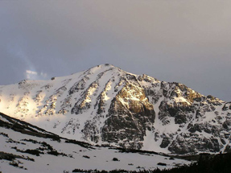
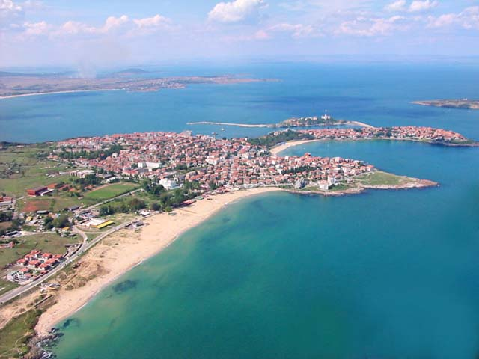
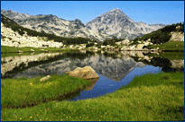
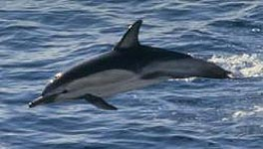
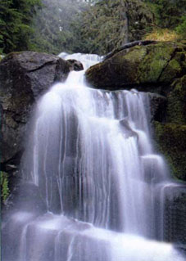
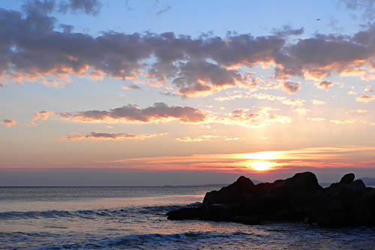
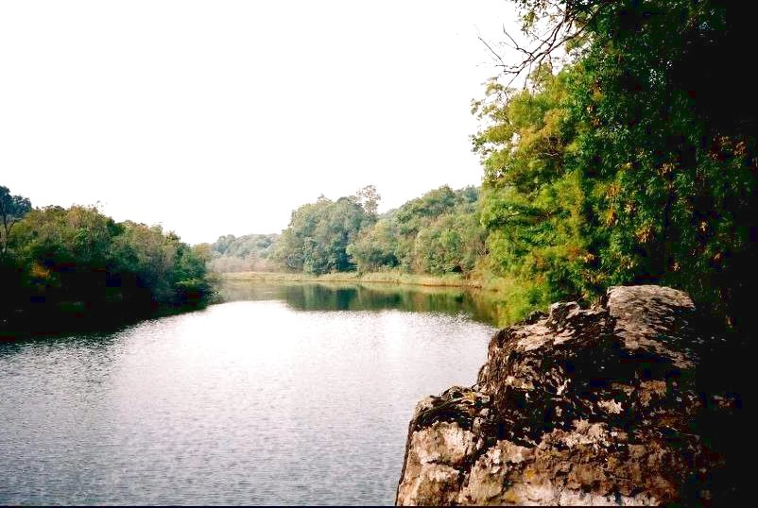
Bulgarian nature

Slide 7
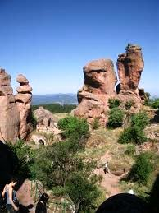
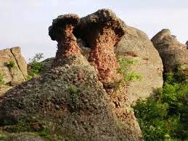
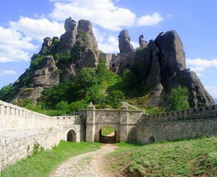
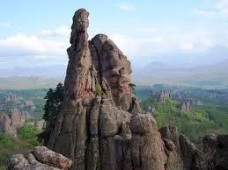
Unique natural formations
The Bulgarian natural phenomenon, the Belogradchik Rocks, have been placed on the New 7 Wonders of Nature Reserve List. These rocks resemble fantastic human and animal figures up to 200 m high and form a strip of land that is 30 km long and 3 km wide. Amongst the rocks is situated the Belogradchik Castle, built in the 1st-2nd century.

Slide 8
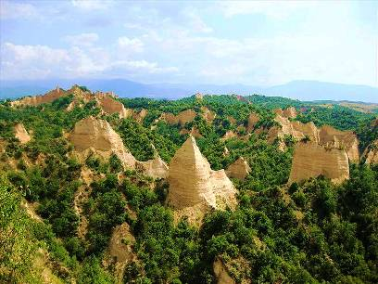
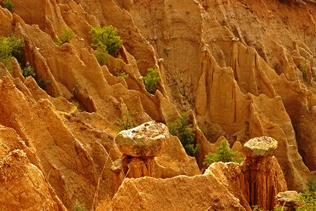
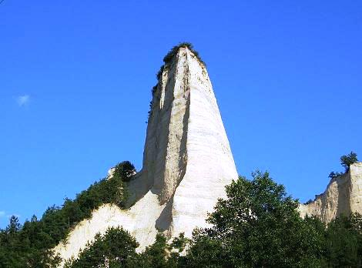
Unique natural formations
The Rock pyramids
in the region of Melnik
in Southern Bulgaria rank among the most remarkable natural phenomena in our country. Over an area of about 17 sq km millenia-long erosion has created a truly unearthly world. One can see various forms: pyramids, giant mushrooms, ancient towers.

Slide 9
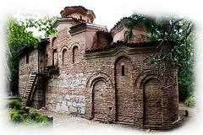
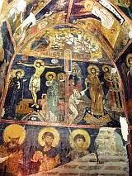
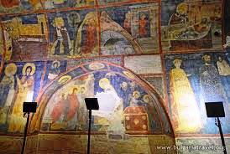
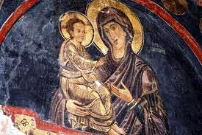
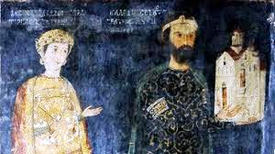
UNESCO World Heritage Sites
Boyana Church
owes its world fame mainly to its frescoes from 1259. They represent one of the most complete and well-preserved monuments of Eastern European medieval art. 89 scenes with 240 human images are depicted on the walls of the church.

Slide 10
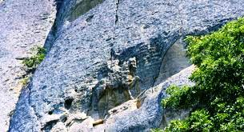
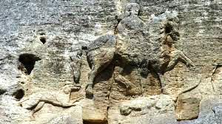
UNESCO World Heritage Sites
Madara Rider,
representing a figure of a horseman is carved into a 100-metre-high cliff. Madara was a sacred place of the Bulgarian state before its conversion to Christianity in the 9th century. It is believed that the inscription depicts the Bulgarian ruler Khan Tervel, who is famous for saving Europe from the invasion of the Arabs in 718.

Slide 11
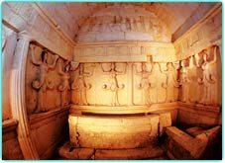
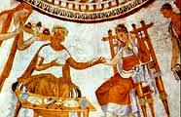
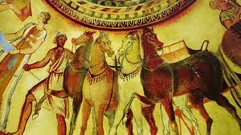
UNESCO World Heritage Sites
Thracian Tomb of Kazanlak
dates from the Hellenistic period, around the 4th century BC. The ceremonial room has a narrow corridor and a round burial chamber, both decorated with murals representing Thracian burial rituals. These paintworks are Bulgaria`s best-preserved masterpieces from the Hellenistic period.

Slide 12
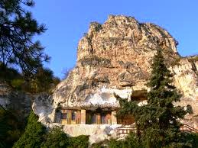
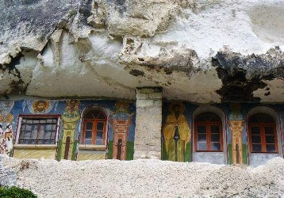
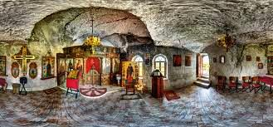
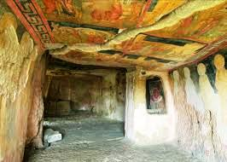
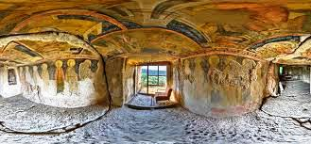
UNESCO World Heritage Sites
Rock-Hewn Churches of Ivanovo
is a complex of cells, chapels, churches and monasteries dug out by the first Bulgarian hermits during the 12th century.

Slide 13
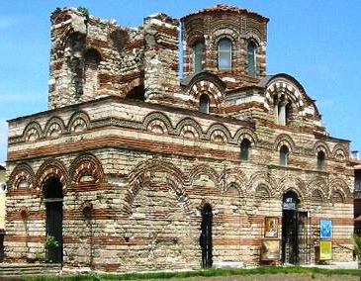


UNESCO World Heritage Sites
Ancient City of Nesebar
is more than 3000 years old. The remains date from the Hellenistic period and include an acropolis, a temple of Apollo, an agora and a wall left from the Thracian fortifications. The Basilica and the fortress date from the Middle Ages, when Nesebar was one of the most important Byzantine towns on the west coast of the Black Sea.

Slide 14





UNESCO World Heritage Sites
Rila Monastery
was founded in the 10th century by St. Ivan Rilski. He was honored one of the most important saints of the Bulgarian Orthodox Church. His tomb became a holy site and was transformed into a monastic complex which played an important role in the spiritual and social life of medieval Bulgaria.

Slide 15



UNESCO World Heritage Sites
The Thracian Tomb of Sveshtary
dates from the 3rd century BC. The tomb has a unique architectural decor, with polychrome half-human, half-plant caryatids and painted murals.

Slide 16


Natural UNESCO World Heritage Sites
Pirin National Park
comprises diverse limestone mountain landscapes with glacial lakes, waterfalls, caves and predominantly coniferous forests. The scenery of the park is of exceptional beauty. The high peaks contrast with meadows, rivers and waterfalls and provide the opportunity to experience the aesthetics of this mountain landscape.
Srebarna Nature Reserve
is a freshwater lake adjacent to the Danube and extending over 600 ha. It is the breeding ground of almost 100 species of birds, many of which are rare or endangered. Some 80 other bird species migrate and seek refuge there every winter. Among the most interesting bird species are the Dalmatian pelican and the mute swan.

Slide 17


Prominent Bulgarians
Petar Danov
was a world spiritual master, leader and founder of a School of Esoteric Christianity. He taught the people to the Universal Ideas and Knowledge of God, Founder of the White Brotherhood in Bulgaria, which is nowadays worldwide.
St. Cyril and Methodius
are the creators of the Slavic alphabet and the first translators of liturgical books from Greek into Old-Bulgarian.

Slide 18


Prominent Bulgarians
John Atanasoff
created the world`s first electronic digital computer between 1939 and 1942. His invention opened the door to world information revolution.
Veselin Topalov
is a world famous chess grandmaster. He became World champion by winning
the FIDE World Chess Championship 2005. He was awarded the 2005 Chess Oscar.

Slide 19


Prominent Bulgarians
Rayna Kabaivanska
is an opera singer, one of the most renowned sopranos in the second half of the 20th century. She has a Master Class for performers of Puccini's works, as well as master classes in Spain, Italy and France. She is also a jury member for many prestigious competitions all over the world.
Valya Balkanska
is one of the most famous Bulgarian folklore singers. Her voice is traveling in deep space on NASA`s “Voyager”.

Slide 20


Prominent Bulgarians
Nikolay Gyaurov
was a Bulgarian opera singer and one of the most famous basses of the post-war period. He was admired for his powerful voice and was particularly associated with roles of Verdi. Gyaurov married the Italian soprano Mirella Freni, and the two singers frequently performed together.
Vasko Vasilev
is world famous violist and concertmaster and creative director of the Royal Opera House-London. He is a teacher of Vanessa May.

Slide 21

Prominent Bulgarian sports people
A lot of Bulgarian sportsmen have made our country famous all over the world by winning medals from different Olympic games and world championships.
Stefka Kostadinova
is the reigning world record holder in the women's high jump at 2.09 m, which she jumped during the 1987 World Championship in Rome. Her world record is one of the oldest in modern athletics. She set seven world records - three outdoors and four indoors. She also holds the women's world record for having jumped over 2.00 m 197 times.

Slide 22


Prominent Bulgarian sports people
Albena Denkova
and Maxim Staviski
are ice dancers. They are the 2006 and 2007 World Champions, the 2003 and 2004 European silver medallists, and the 2006 Grand Prix Final champions. Denkova & Staviski are the first Bulgarian figure skaters to medal at the World Figure Skating Championships.
Yordan Yovchev
is the first ever male gymnast to take part in six Olympic Games. He won 1 silver and 3 bronze Olympic medals; 4 golden, 5 silver and 4 bronze medals in World championships; 1 gold, 6 silver and 2 bronze medals in European championships.

Slide 23


Prominent Bulgarian sports people
Hristo Stoichkov
is the most successful Bulgarian soccer player of all time. He played with FC Barcelona from 1990 to 1998. His awards include the European Golden Ball, the European Golden Shoe, the World Cup Bolden Boot and the World Cup Bronze Ball.
Ivet Lalova
is the fastest white woman on the planet. In her career she has 40 medals: 30 gold ones and 10 silvers, all of them are on 60, 100
and 200 m individual sprints. She was chosen "Miss Charm" for the Olympic Games in Athens by internet inquiry.

