Slide 1


SU “Sveti Sedmochislenitsi”
Targovishte
BORYANA BOTEVA
Some Certificates And Professional Awards

Slide 2



Slide 3
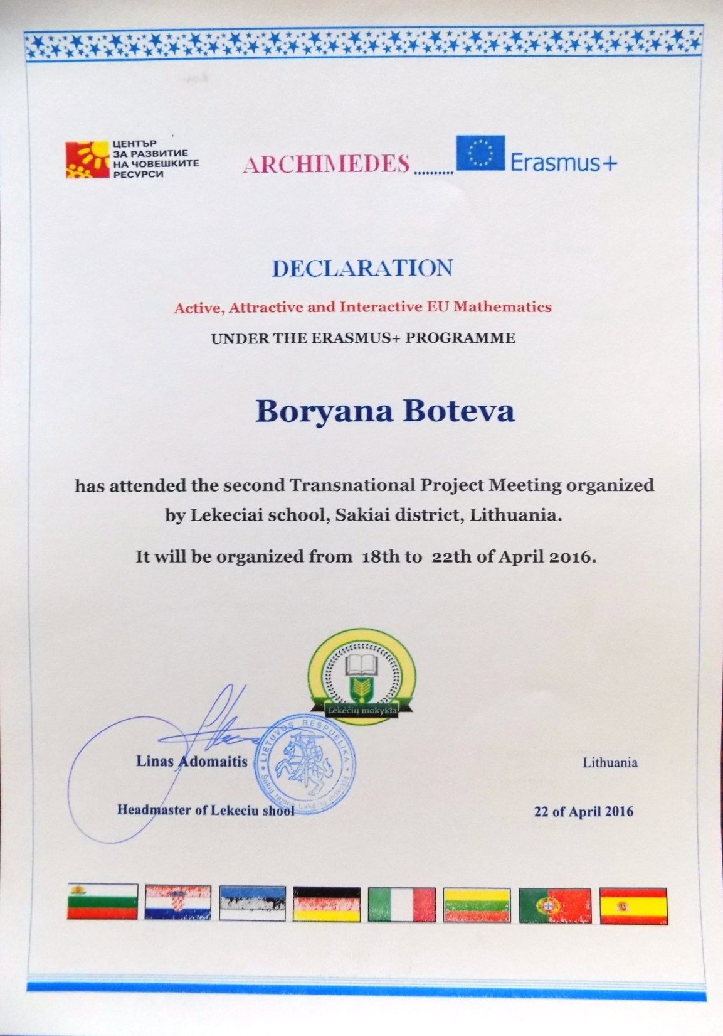

Slide 4
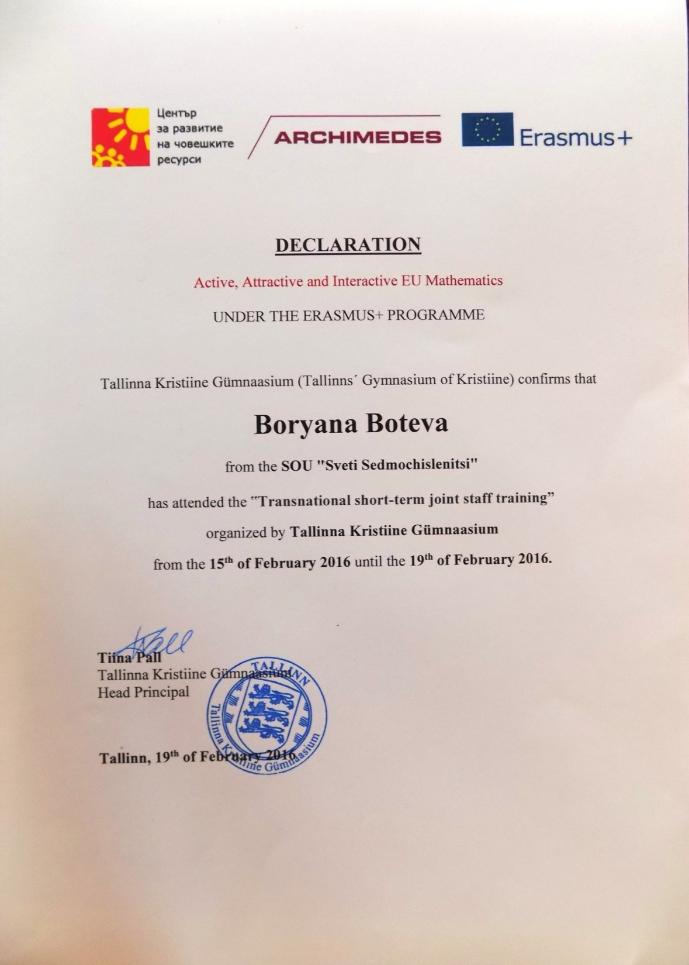

Slide 5

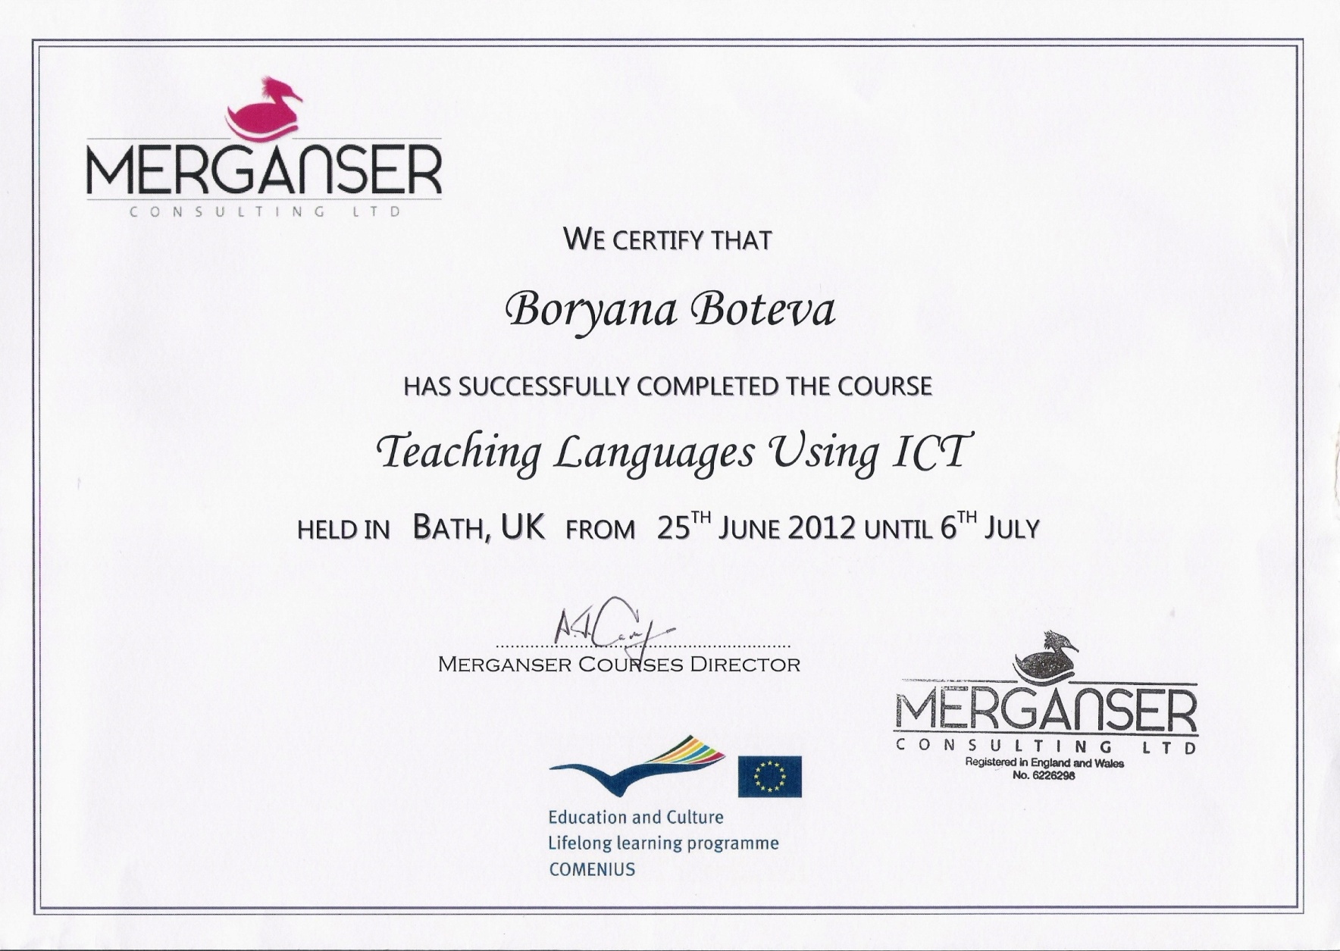
.

Slide 6
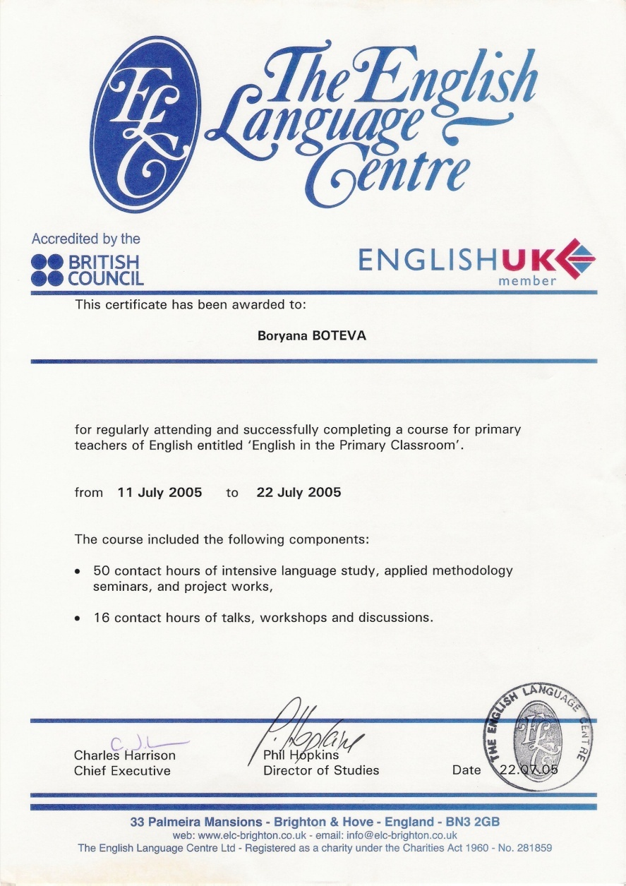
.

Slide 7
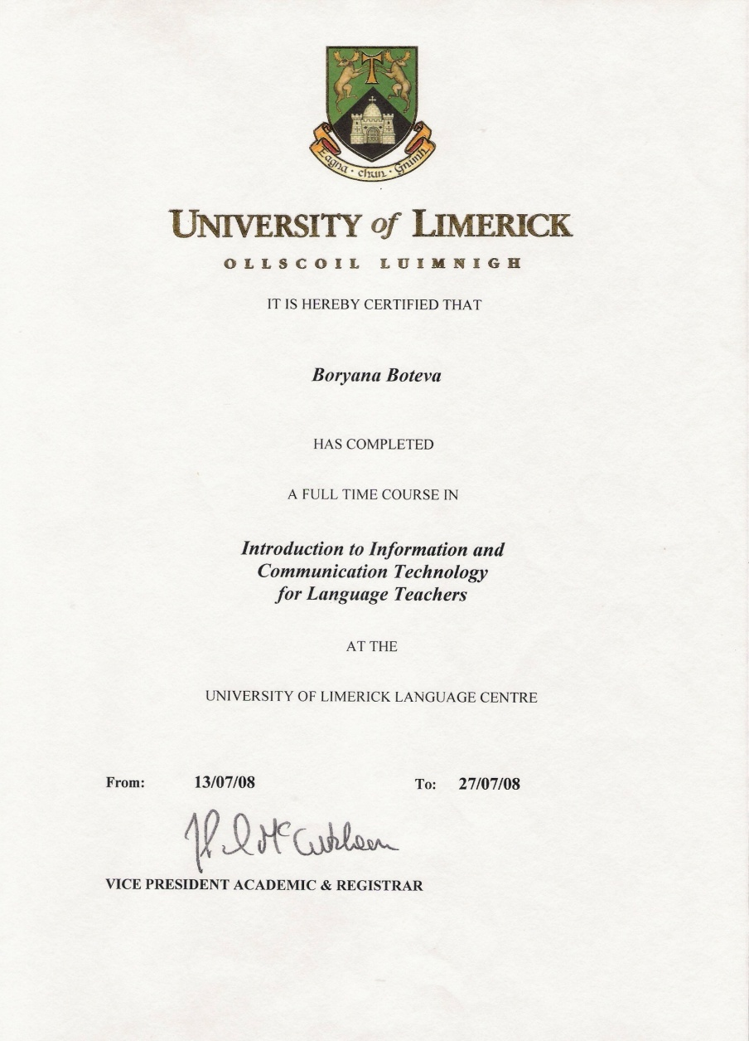
.

Slide 8
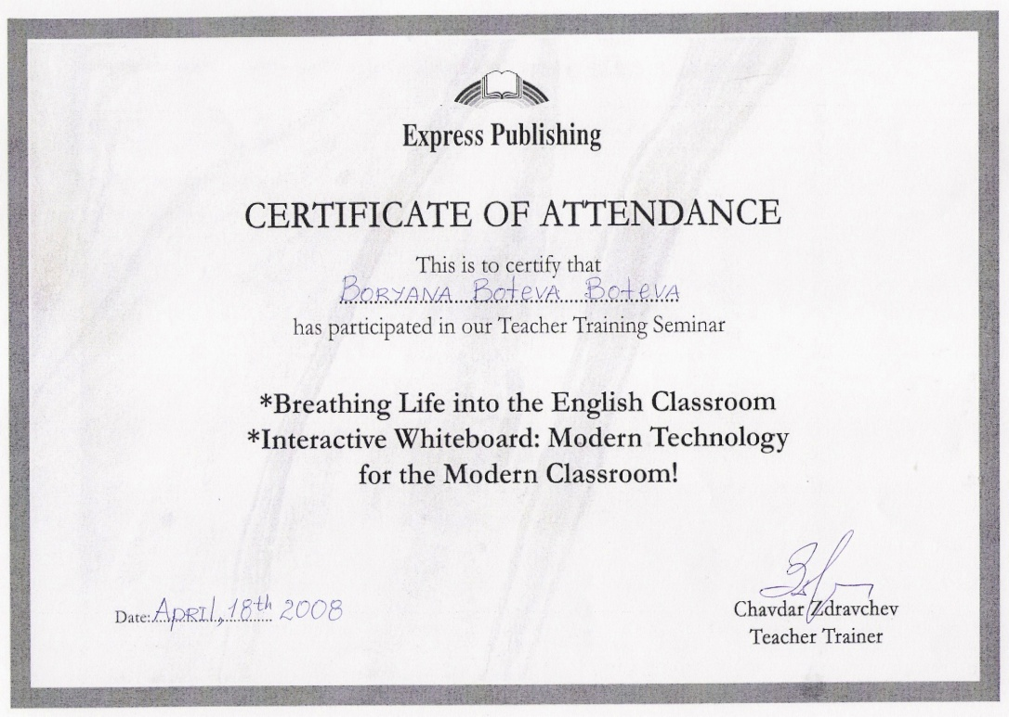
.

Slide 9
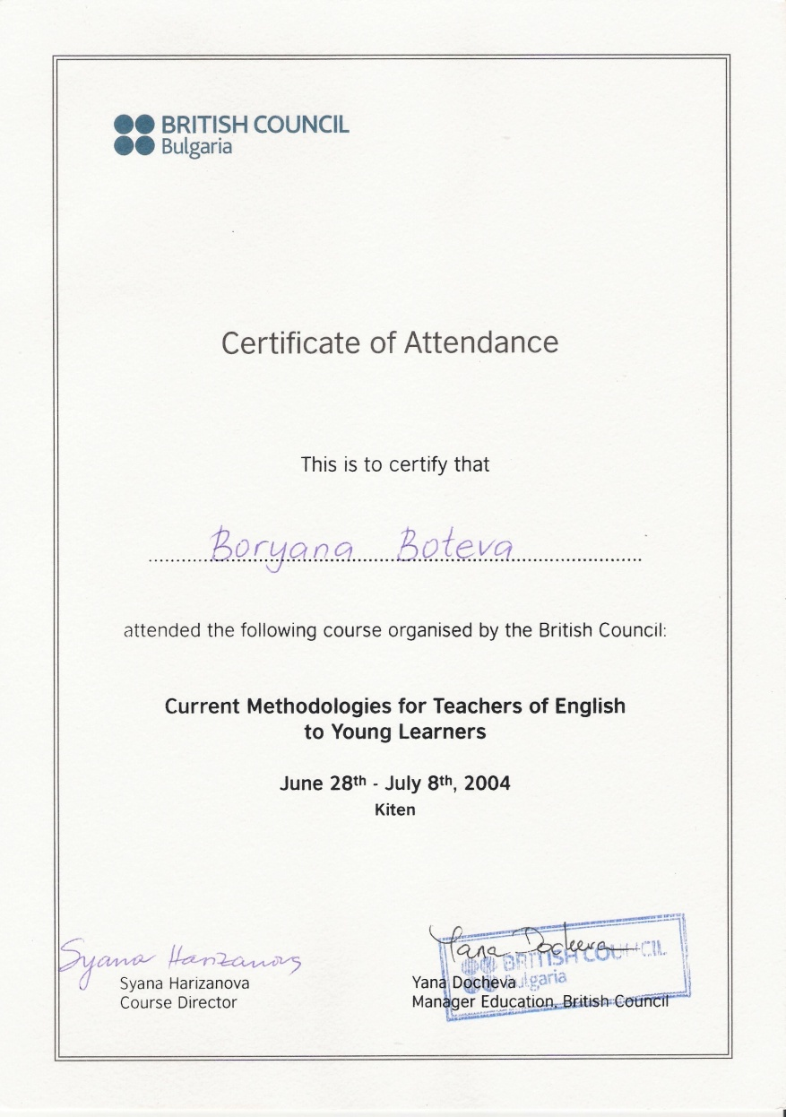
.

Slide 11


Slide 12


Slide 13
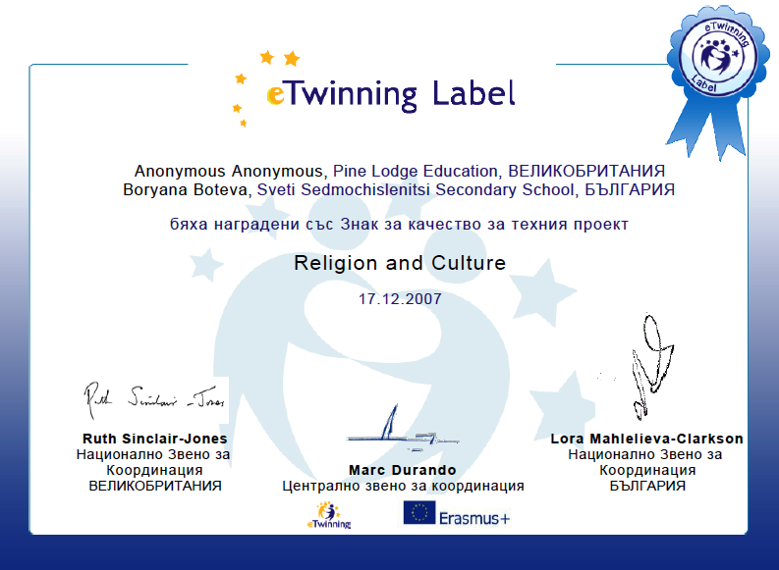

Slide 14
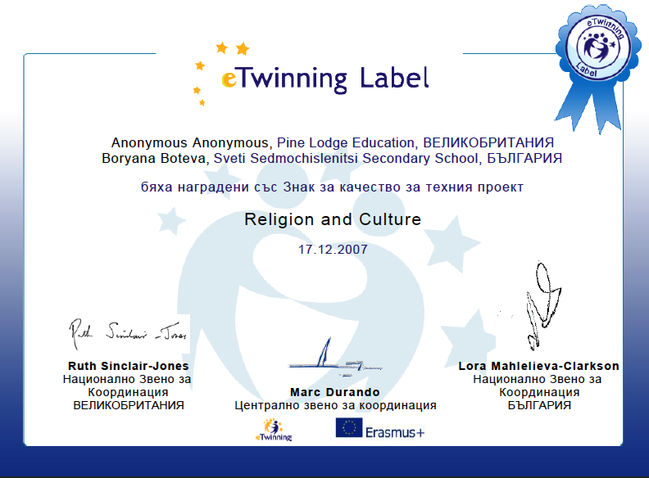

Slide 15


Slide 16
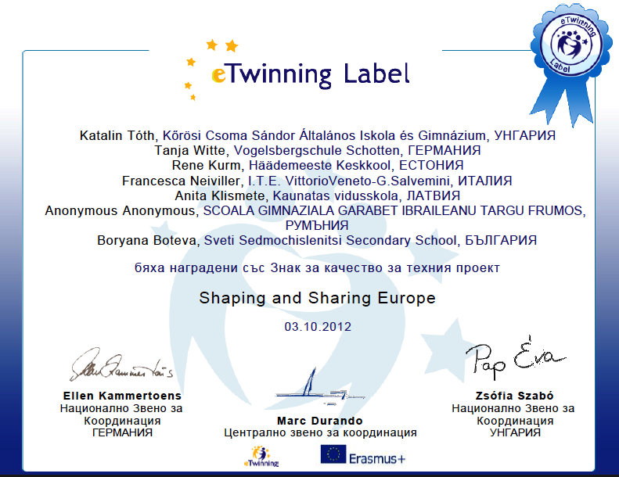

Slide 17
