Slide 1
Project Based Learning
Using PBL in the Classroom

Slide 2
What is PBL? / Why PBL?
using authentic, real-world projects in the classroom.
involves critical thinking, collaboration and communication.
students have to perceive projects as personally meaningful.
deepens knowledge and builds skills for the future.
Notes:
Bender, William. 2012. Project-Based Learning: Differentiating Instruction for the 21st Century. California: Sage Ltd.
Larmer, John and John R. Mergendoller. 2010. 8 Essentials for Project-Based Learning. Educational Leadership 68 (1), 52-55.

Slide 3
What are the five keys to rigorous PBL?
A)
1. In your opinion, what types of projects are most/ least successful with your learners? Why?
2. How do learners react to project work?
3. What might some of the essential keys to project-based learning be?
B)
Write down the five keys given (headings only).
Compare your answer to question A3 with the tips from the video.

Slide 4
https://www.youtube.com/watch?v=hnzCGNnU_WM
http://bie.org/project_search

Slide 5
Discussion
1. What do you think of the five keys from the video?
2. What’s the most useful information you took from the video?
3. How do learners reflect on their involvement in a project in the video?

Slide 6
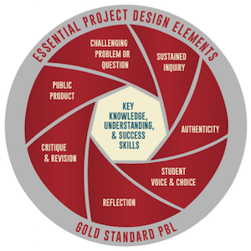
Notes:
Taken from Buck Institute of Education Blog

Slide 7
Some Project Ideas...
Digital Citizenship
Your Digital Footprint : Students make an infographic on digital footprints
Primary School
Family Ties : Students interview grandparents, parents and create their own journals and timelines
Trash to Treasure : Students learn about the environment and present a recycled product
Notes:
Taken from BIE

Slide 8
Some Project Ideas...
Secondary School
Does History Repeat Itself? : Students research and explore the question before making an audio recording
Chalk Dust or Guitar Hero? : Students investigate how to use their ‘everyday’ tech to create a lesson plan
A Hero in My Eyes : Students create a multimedia presentation
Notes:
Taken from BIE

Slide 9
Useful Resources
Edutopia
PBL-online.org
21classes.com
rubrics4teachers.com
Google drive
Pinterest

