Slide 1
The Flipped Classroom

Slide 2
By the end of this lesson we will have...
explored the flipped classroom approach
examined resources for the flipped classroom
adapted a video for the flipped classroom

Slide 3
What do you already know?
1. Have you heard of the flipped classroom approach?
2. How does it work?

Slide 4
Now compare!
The Flipped Classroom Infographic

Slide 5
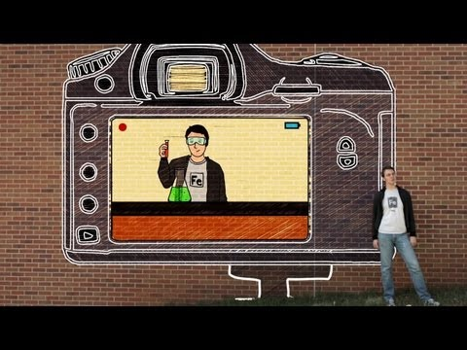
Teaching for tomorrow: Flipped Learning

Slide 6
Resources...
Have you ever watched a TED talk?
TED
John McWhorter's TED Talk
Have you ever taken any of the TED-Ed lessons?
TED-Ed

Slide 7
Resources...
Have you ever taken any of the lessons on Khan Academy?
khanacademy.org

Slide 8
Can I flip it?
How would flipped learning fit into your context?

Slide 9
Flipping our classrooms
Do you think that video content is the only way to flip the classroom?
Flipping the classroom: 27 ways

Slide 10
Things to consider...
Before you flip...

