Slide 1
Welcome to Dublin!
Céad míle fáilte

Slide 2
Aims...
Paperwork
Icebreakers
Course and Timetables
Evening Entertainment

Slide 3
First Day Forms
Wifi Password: GreenDoor

Slide 4
Teaching Styles

Slide 5
Discuss with your partner / group...
1. Do you work in primary, post-primary or third level?
2. What subject(s) or course(s) do you teach?
3. What’s the most enjoyable thing about being a teacher?
4. What’s the most challenging thing about being a teacher?
5. What technology / internet tools do you use in the classroom?
6. What websites would you recommend teachers to use and why?

Slide 6
Icebreaker

Slide 7
Fruitbowl

Slide 8
What kind of icebreakers do you use in your class?

Slide 9
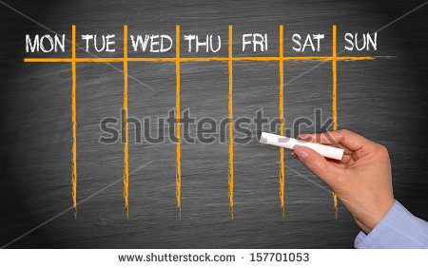
Course and Timetable
Group 1 Katie
Group 2 Mick

Slide 10
Alpha College
Staff Members
Katie: 00353863380332
Computer access
Dublin Bus Letters
Tour Builder
Directions

Slide 11
What’s on...
Evening Entertainment

