Slide 1
Targovishte:
A little piece
of heaven

Slide 2
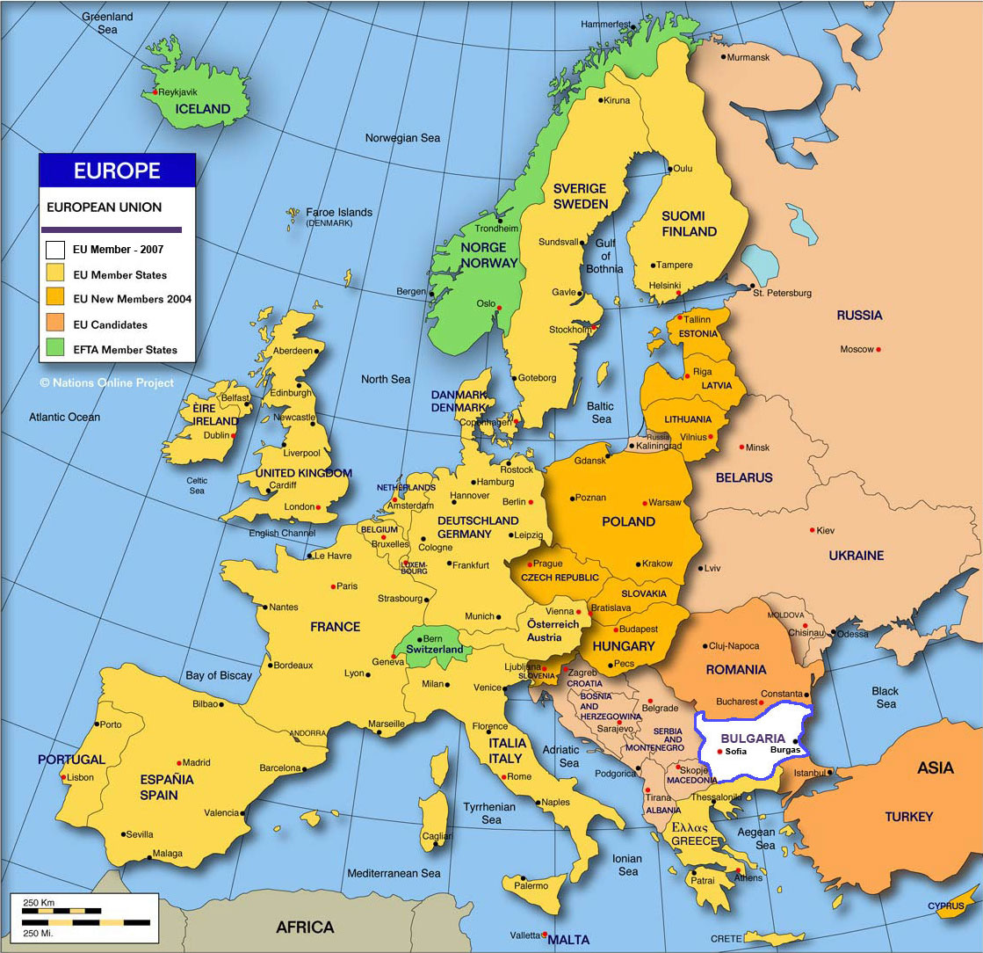
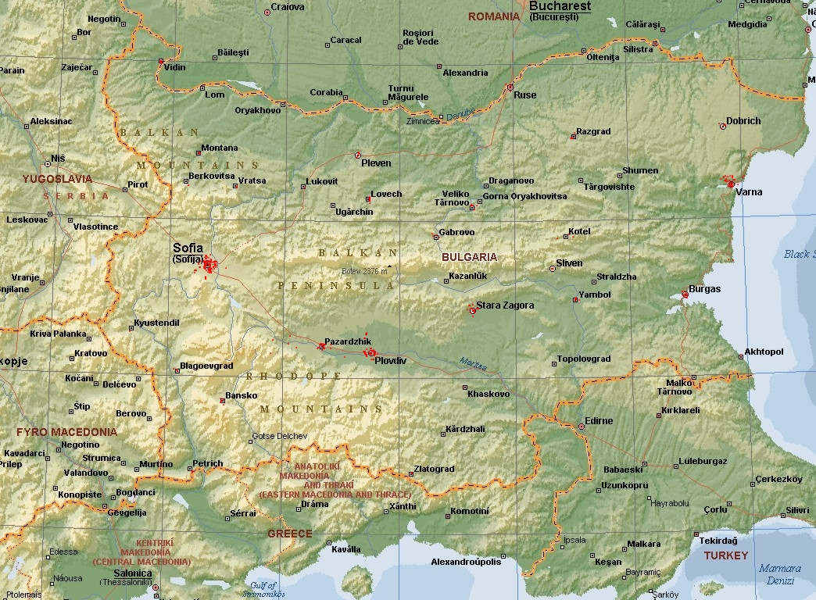
This is the place which you should see…

Slide 3
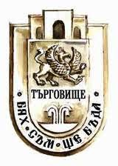
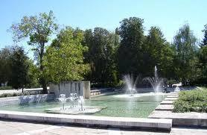
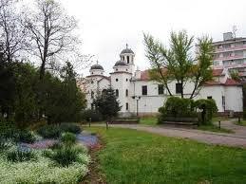
Location:
In the north-east part of Bulgaria
At the southern foot of the low mountain of Preslav
On both banks of Vrana River
Population:
46 724 residents (in march 2010)
Climate:
Temperate continental
Motto:
I was,
I am,
I will be!
Coat of arms

Slide 4
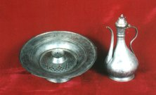
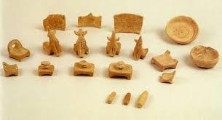
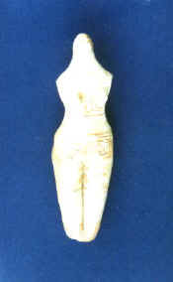
Town history
There are archeological evidences proving that the area has been inhabited since the 5th-4th century BC
First mentioned in 1573
It was already an administrative centre in 1658
In the 18th and 19th centuries it became a famous market for animals and craft products
In 2000, ruins of an ancient Roman town called Missionis were unearthed near Targovishte
Cult scene from the village of
Ovcharovo, Targovishte district
Clay idol

Slide 5
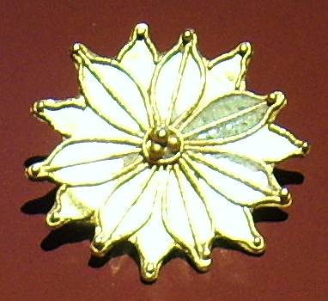
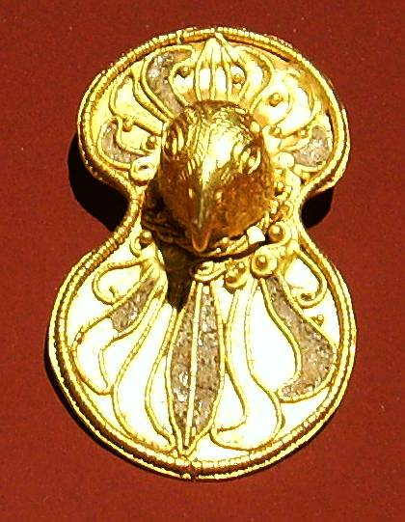
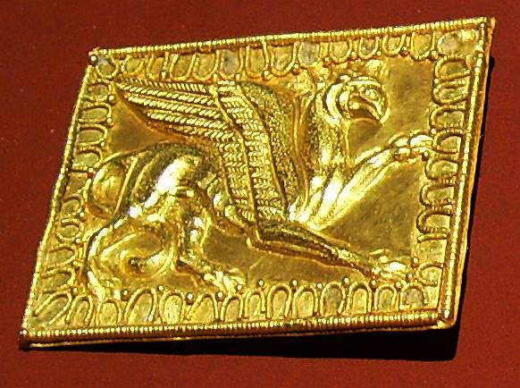
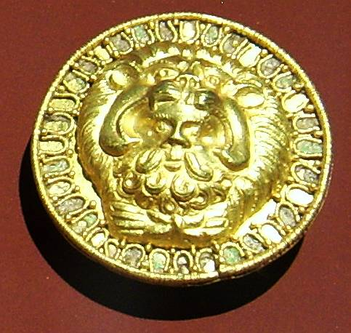
Golden treasure from the village of Kralevo,
Targovishte region – 3rd century BC

Slide 6
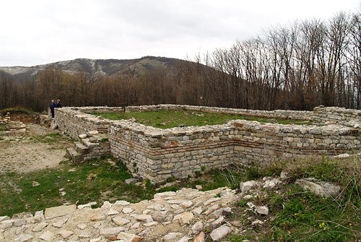
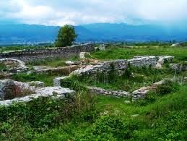
The ancient city of Misionis
Situated on a mountain hill near Targovishte
Founded in the mid-fifth century
The construction of the fortress started during the reign of Emperor Justinian I and lasted until the early 6th century

Slide 7
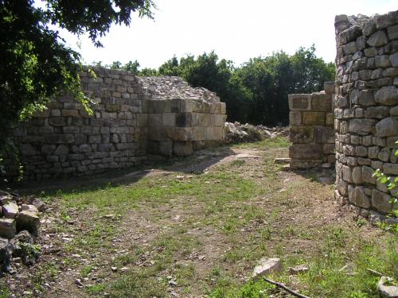
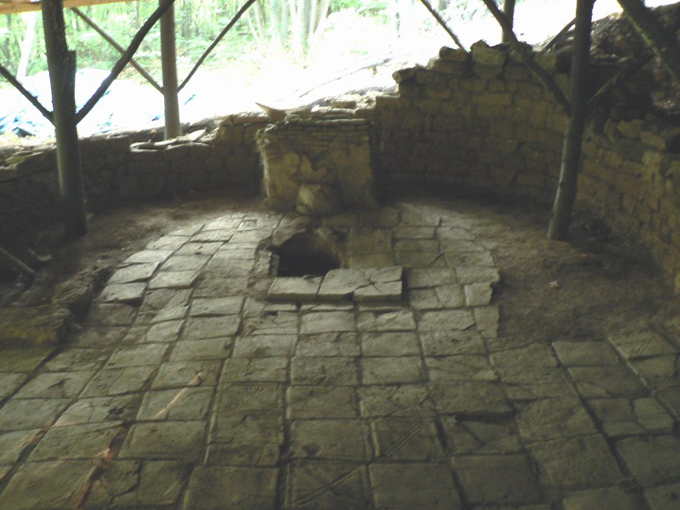
Krumovo Kale fortress
A new Bulgarian settlement was founded on the ruins of the ancient Misionis in the 9th-10th century. It reflected on the culture and economic development of the nearby royal city of Veliki Preslav
In 1153 Ali Mohamed Al-Idrisi, an Arabian traveler and geographer, wrote: “…a big and prospering city. The market places are crowded and the gifts of the nature are bountiful …”

Slide 8
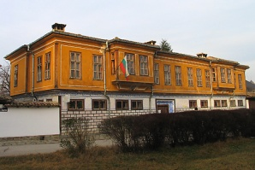
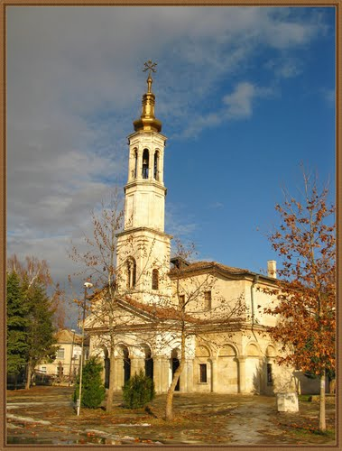
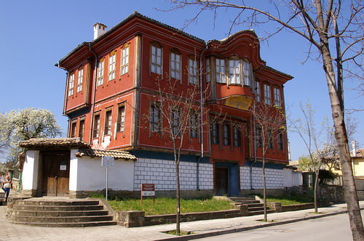
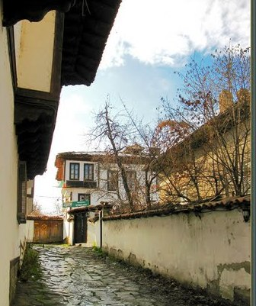
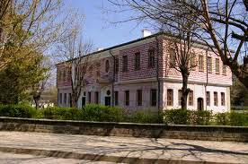
The old quarter Varosha
Presents the typical style of the Bulgarian National Revival
One can see:
The Holy Assumption of the Mother of God church
The old Sveti Sedmochislenitsi school (built in 1863), currently the town historical museum
Hadzhi Angelova house, currently the town etnographic exposition
Hadzhi Roussi house

Slide 9
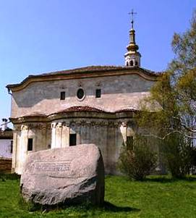
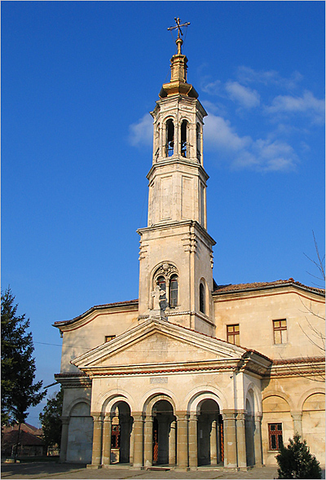
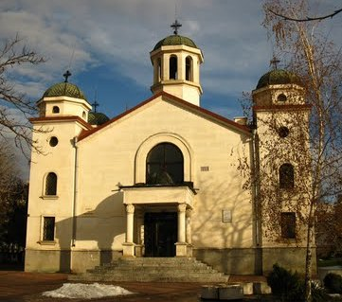
Targovishte churches
St. John of Rila church, named after Saint John of Rila (876 – c. 946) who was the first Bulgarian hermit. Andrey, Metropolitan of New York and the diocesan prelate of the Bulgaria Eastern Orthodox Diocese of the USA, Canada and Australia was buried in the church after his death in 1972
The Holy Assumption of the Mother of God church, built in old Bulgarian style in 1851. The bell tower is a project of the Italian engineer Furlani. It is covered with gold

Slide 10
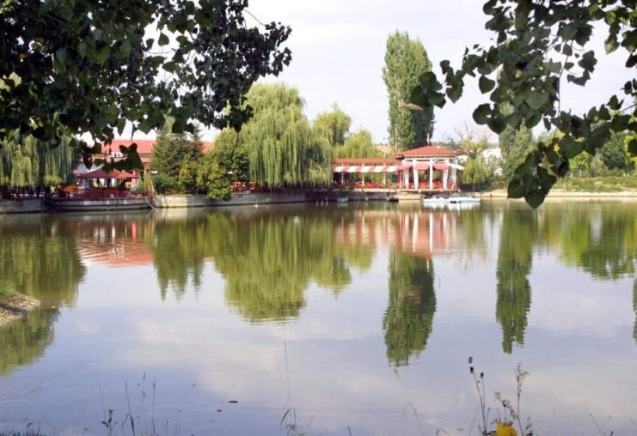
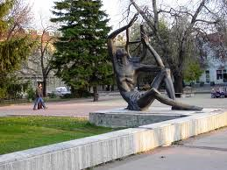
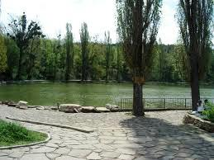
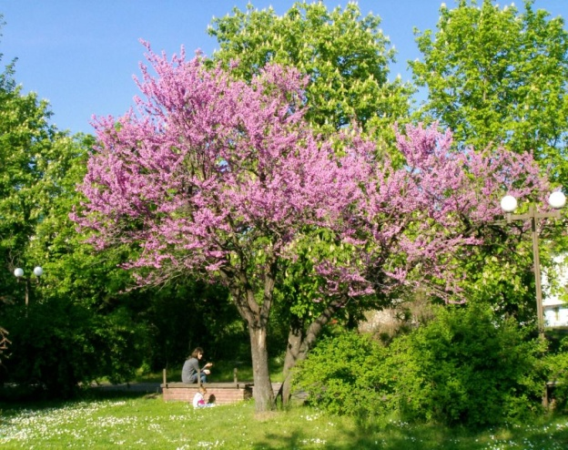
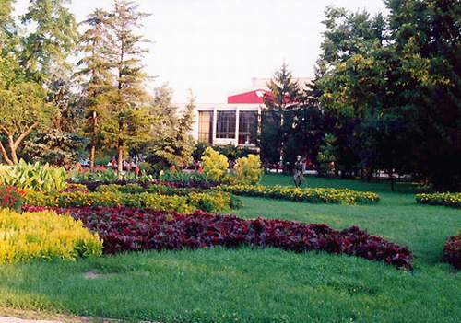
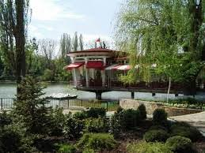
The most attractive and attended parks are:
“Borovo oko” park
The Central Garden
Notes:
10

Slide 11
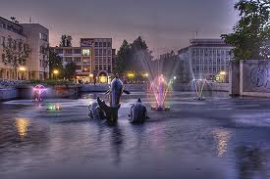
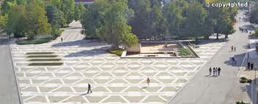
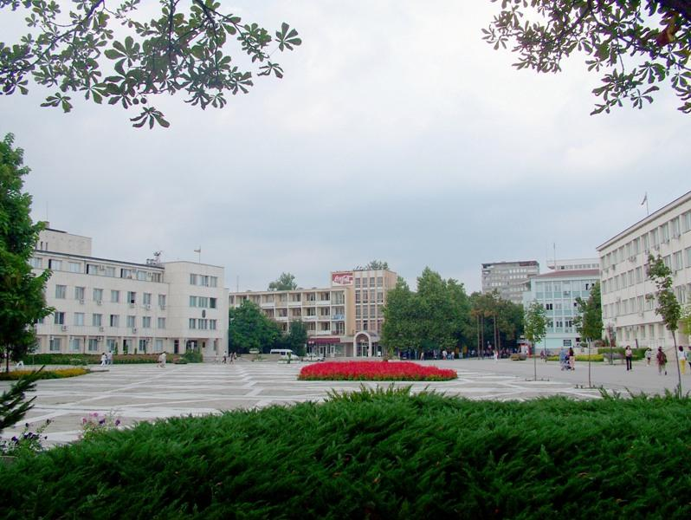
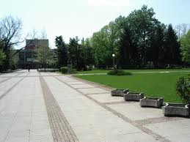
The Central garden and walkways are Targovishte citizens` favourite green areas

Slide 12
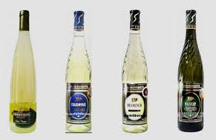
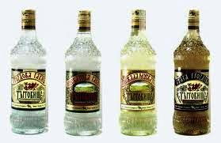
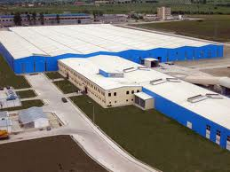
Industry
One of Bulgaria's largest wine production factories is located there. It produces some of Bulgaria's best wine
On the territory of the region operates one of the largest manufacturers of lead-acid batteries under the license of VARTA company
Targovishte is a home to one of the largest glass factories in Europe
Production of soft drinks under the license of Coca-Cola company
Other industries developed in the region are:
tailoring
production of refined sunflower oil
construction
furniture making
woodworking industry
trade and services

Slide 13
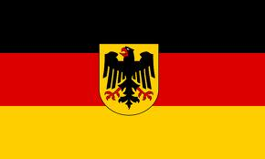
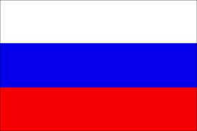
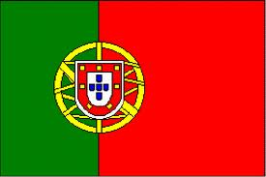
Twin towns
Cottbus, Germany
Targovishte,
Romania
Smolensk, Russia
Santa Maria da Feira,
Portugal
Kozani, Greece
Suresnes, France
Waterloo, Iova,
United States

