Slide 1
Svety Sedmochislenitsi
Secondary School
Targovishte, Bulgaria

Slide 2
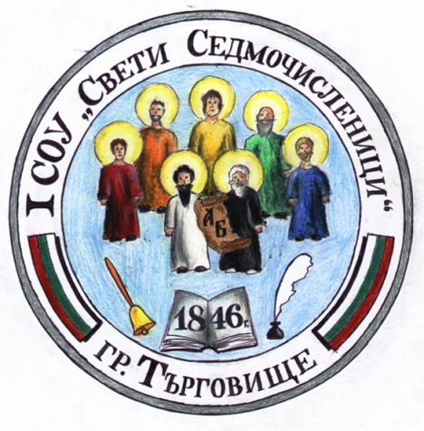
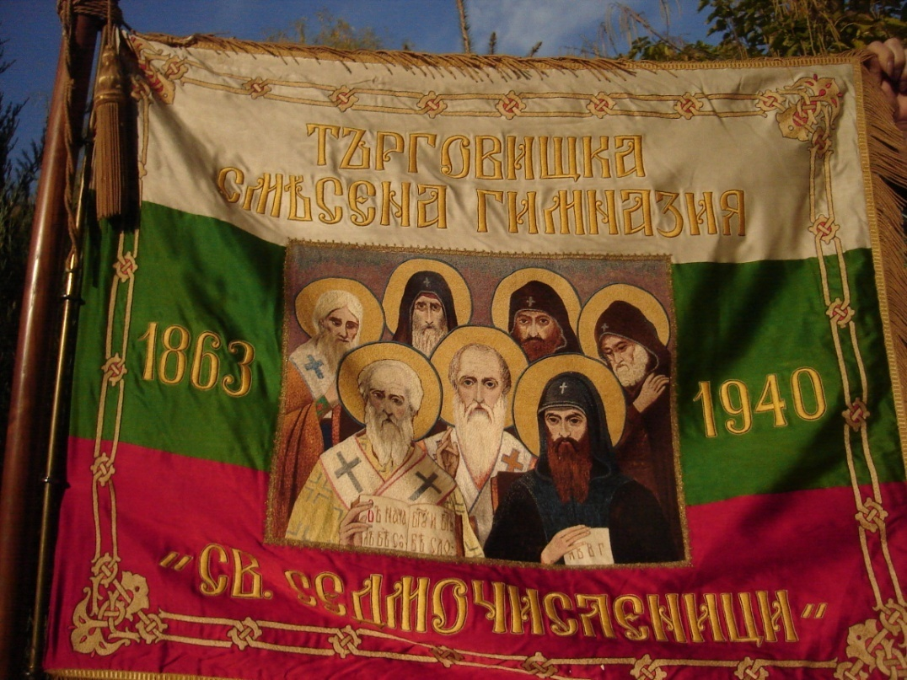
The official symbols of our school
Coat of arms
Flag
Logo

Slide 3
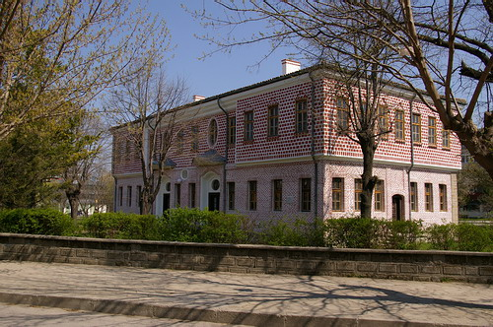
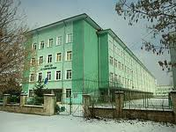
School history
A school was made in 1846. It was named after Sveti Sedmochislenitsi (Seven Saints).
Our school is a successor of that school and has 167 years of history.

Slide 4
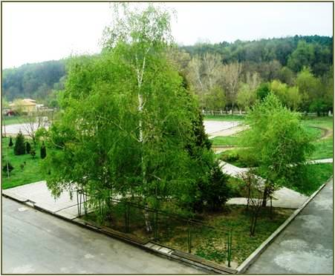
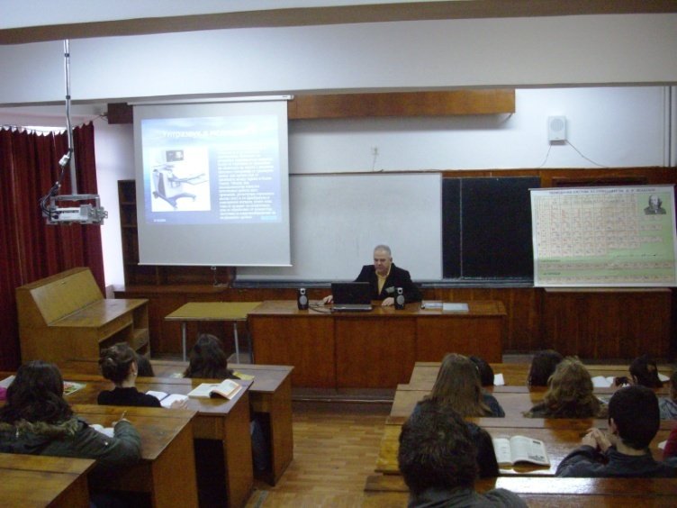
General information
Number of teaching staff: 70
Number of students: 900
Students` age: 6-19
Facilities:
  Eco-friendly area
  Large green yard
  45 safe, modern, lively and colorful classrooms wholly centered upon children and active learning
  6 computer labs
  Nature and Mathematical Science Center
  School hall
  3D Conference hall

Slide 5
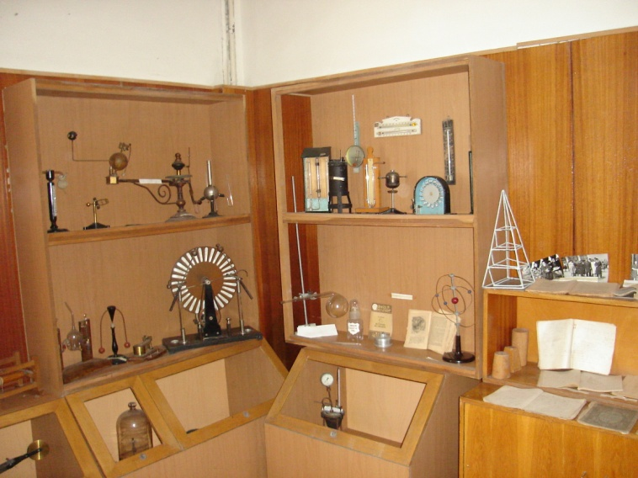
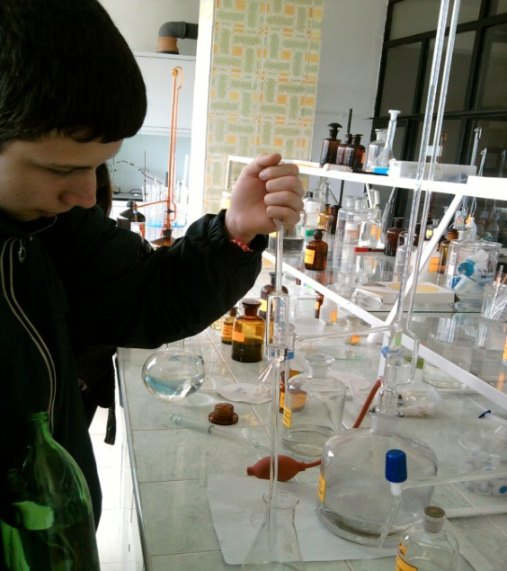
General information
  Multimedia in all classrooms
  10 interactive whiteboards
  85 computer systems
  35 laptops
  MultiSeat computer system
  Modern sports complex –
  outdoor and indoor
  School library
  School museum
  School Canteen
  School Hostel
  2 food pavilions

Slide 6
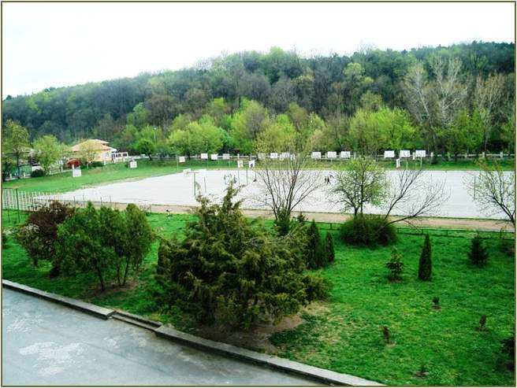
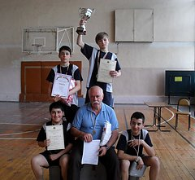
School sports complex
Large gym
3 sports halls
Table tennis hall
Outdoor playgrounds
Main games pitches and grounds
Fitness centre
Aerobic and dance studio
Running track
Tennis court
Long jump pit

Slide 7
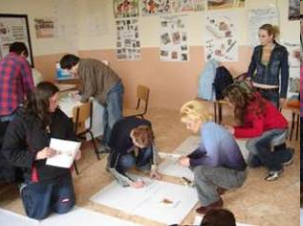
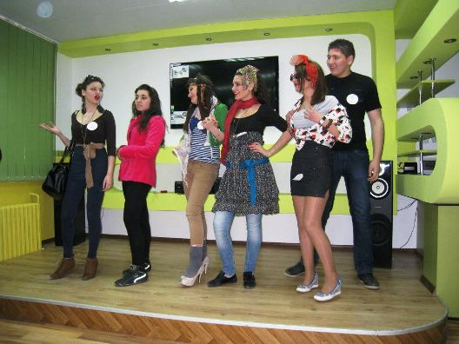
Our school offers …
A first rate education
A wide range of co curricular and after-school activities
Over 40 clubs, studios and sections
An active Student Council (School Parliament)
Opportunities for taking part in international partnerships and collaborative activities
English and German taught as foreign languages

Slide 8
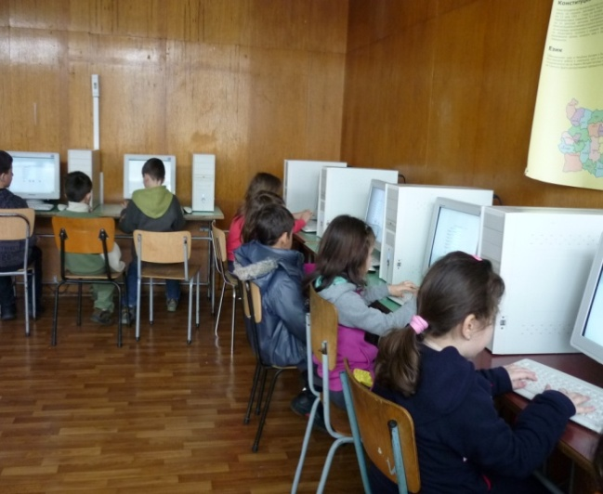
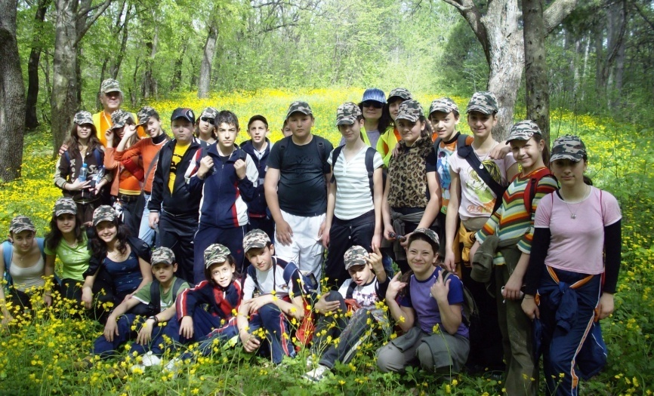
After – class activities
Computer study groups for the
youngest students (1st-4th grade)
Foreign languages study groups
Health clubs
Eco clubs
Junior Achievement programmes
Sports clubs and sections
Tourist groups
Music ensemble
Dancing studio
Drama studio

Slide 9
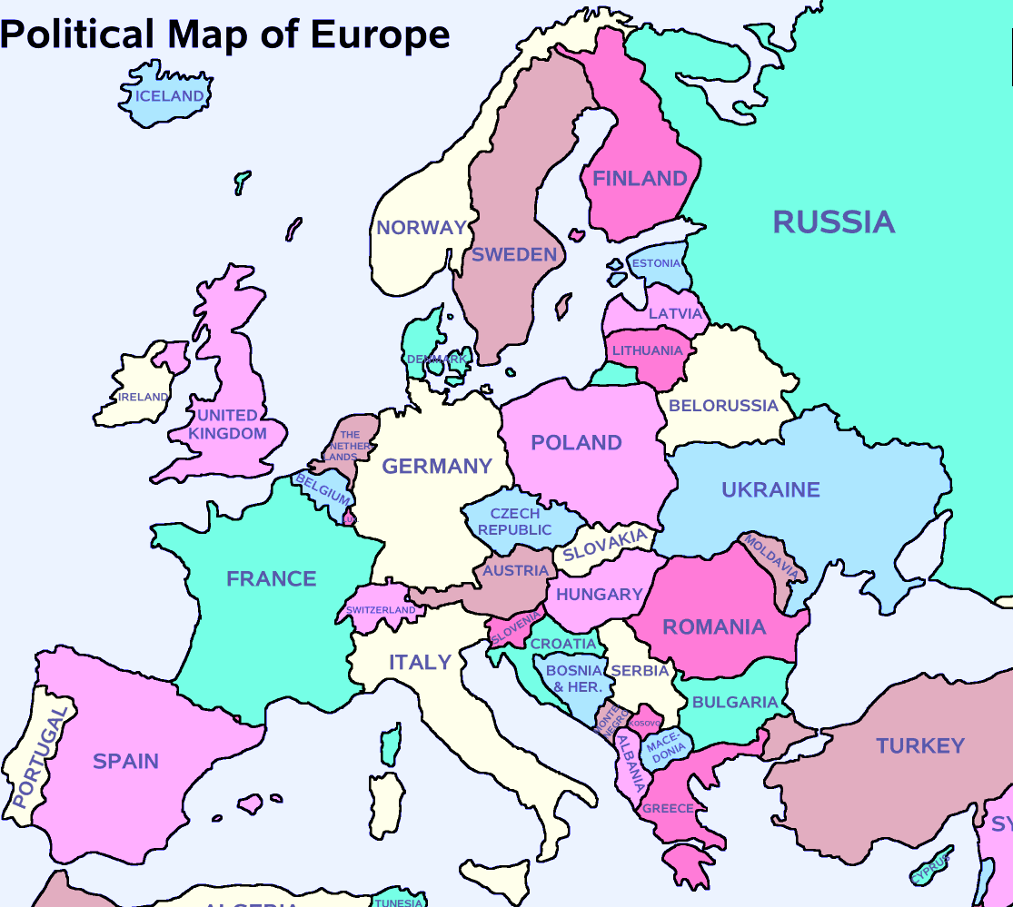
Our partners all around Europe
Germany
Hungary
Estonia
Romania
Greece
Latvia
Italy
United Kingdom
Spain
Portugal
France
Lithuania
Slovakia
Croatia
Poland
Belgium

Slide 10
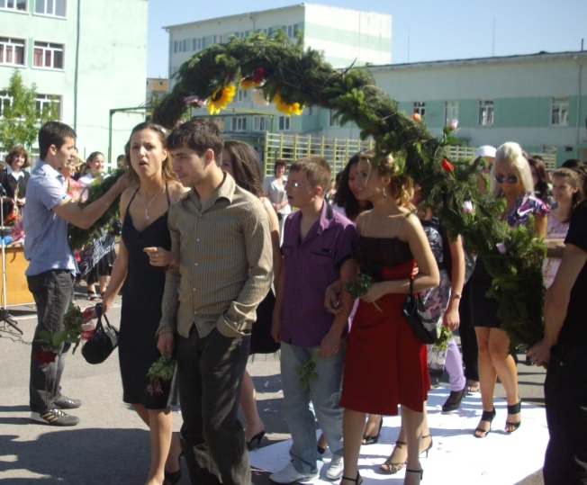
Our school:
Where Tomorrow Begins

